Slide 1
HOSPITAL INFORMATION SYSTEM

Slide 2

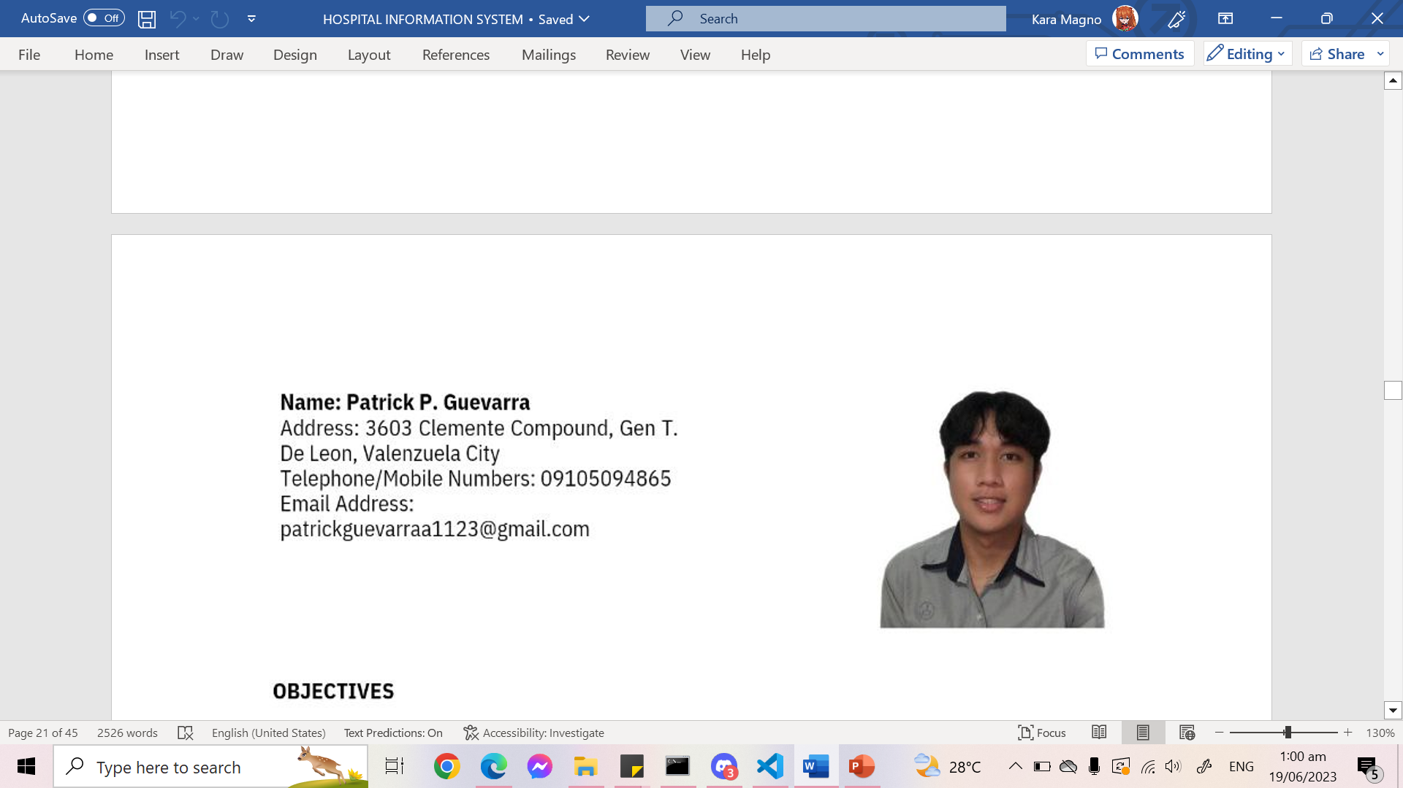
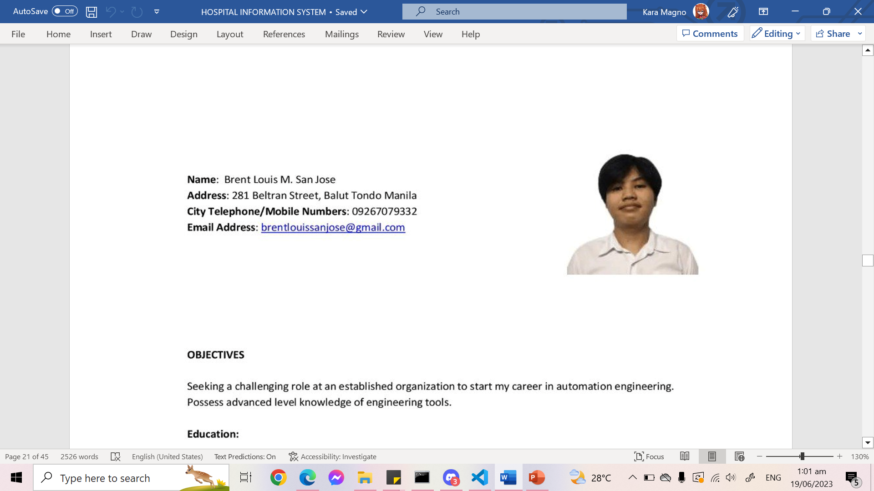
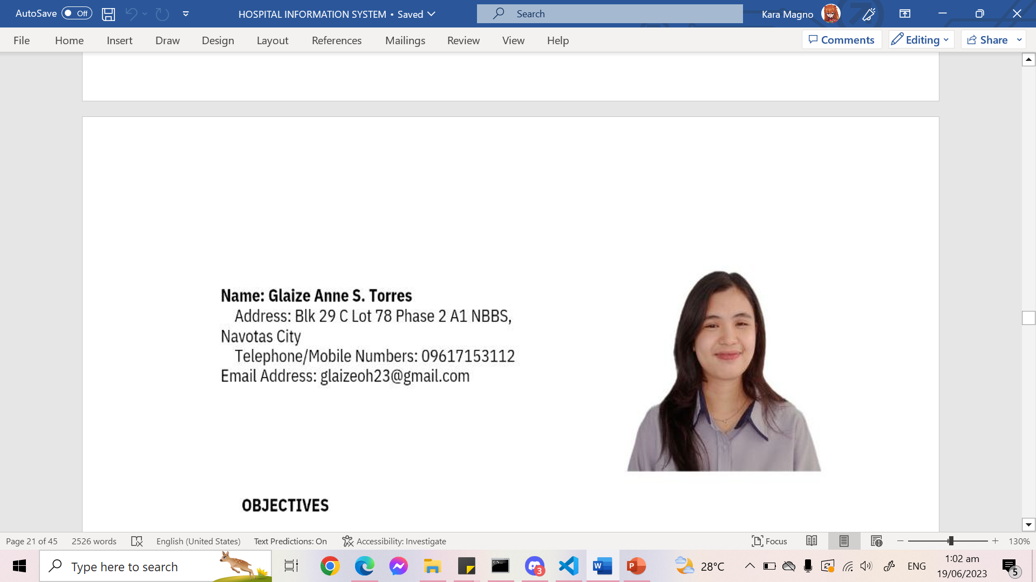
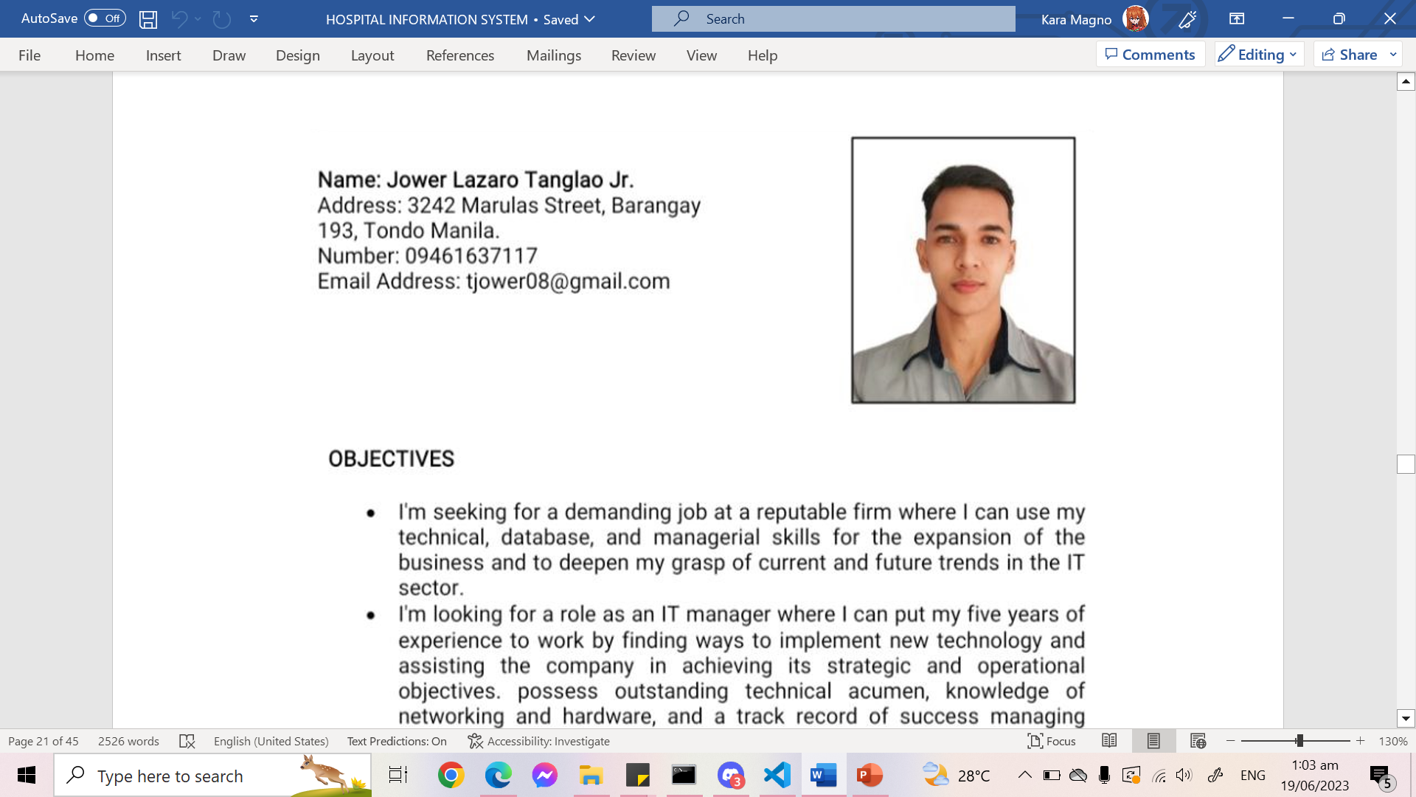
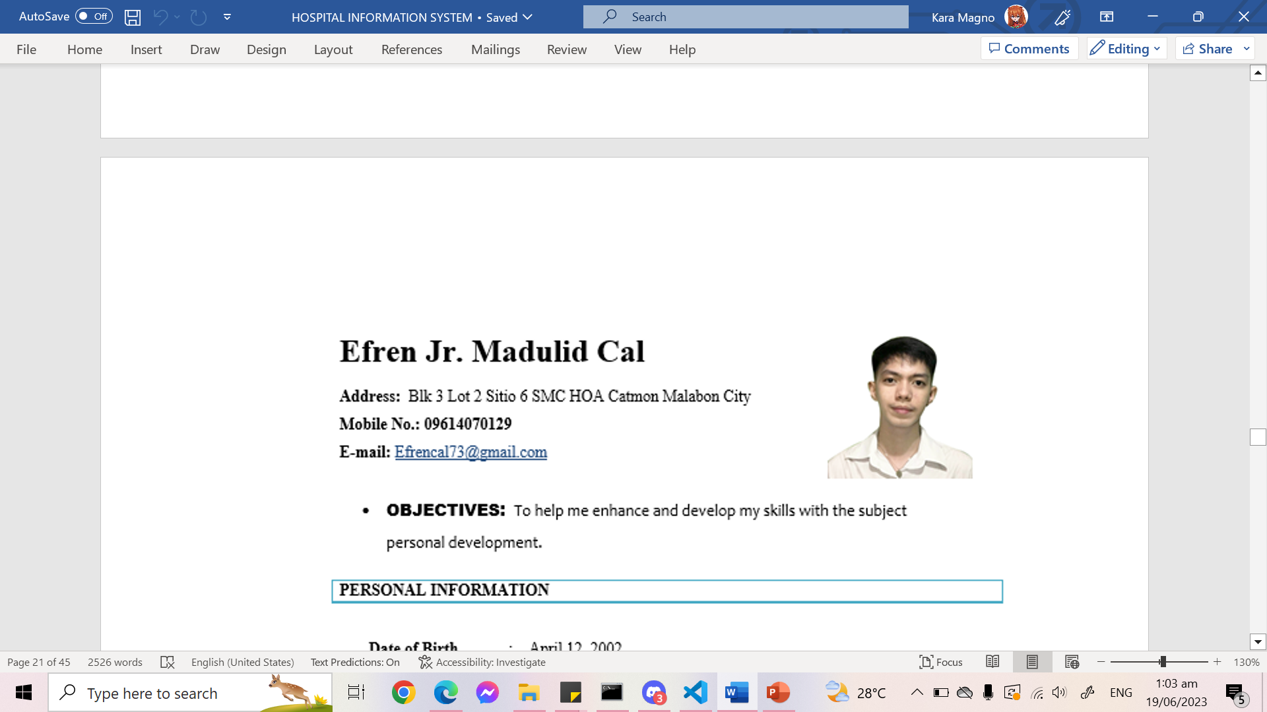
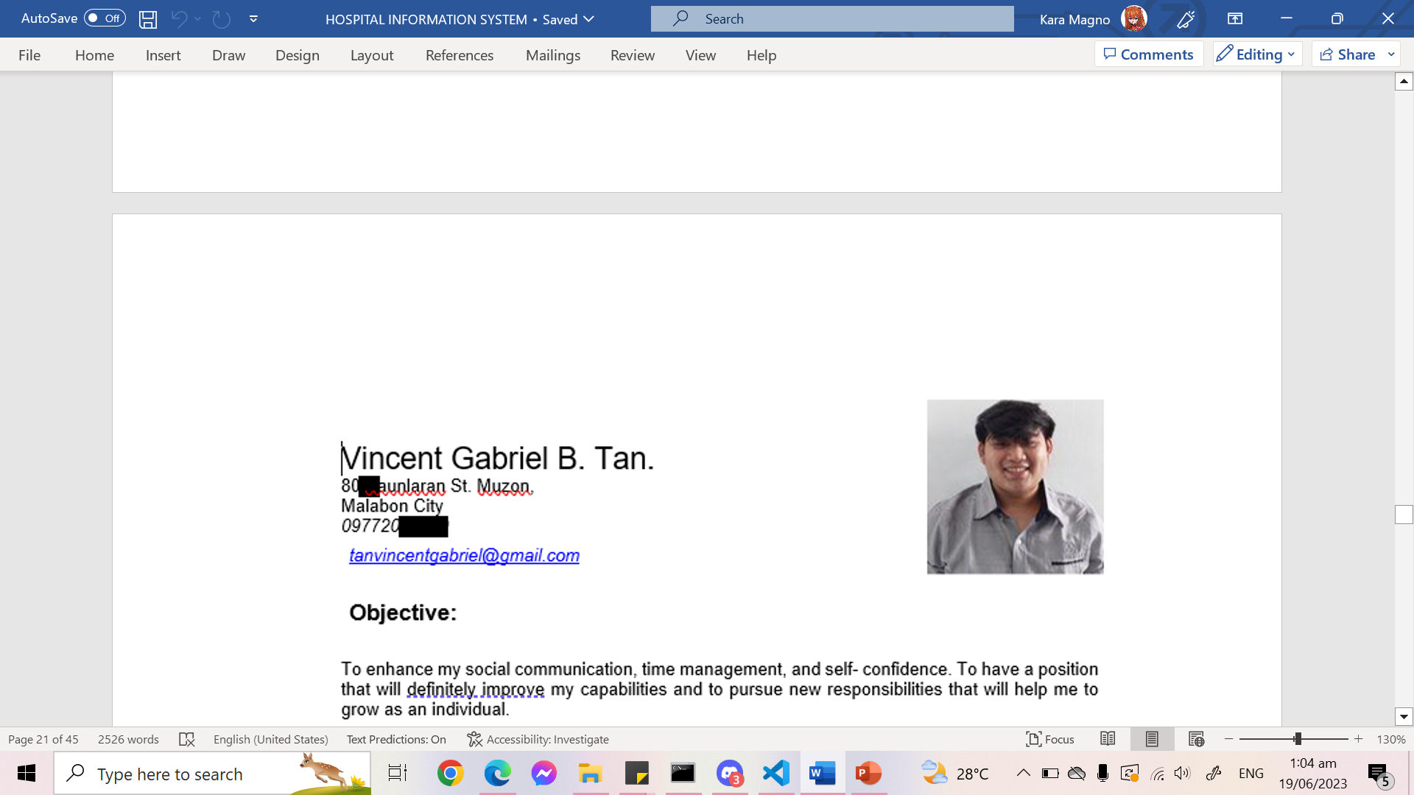

OUR TEAM
Torres, Glaize Anne S.
Tanglao Jr., Jower L.
Del Rosario, John Einfrey M
Guevarra, Patrick P.
San Jose, Brent Louis M.,
Cal, Efren Jr. M
Tan, Vincent Gabriel B.
Magno, Kara Caitlin E.

Slide 3

CLIENT
Hospital

Slide 4
OBJECTIVES OF THE STUDY
GENERAL OBJECTIVE:
Develop a Hospital Management or Information System

Slide 5
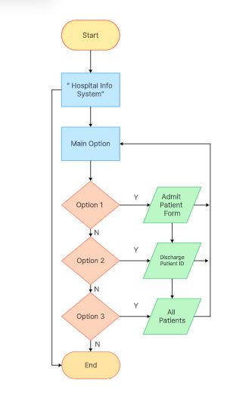
START/MAIN MENU FLOWCHART

Slide 6
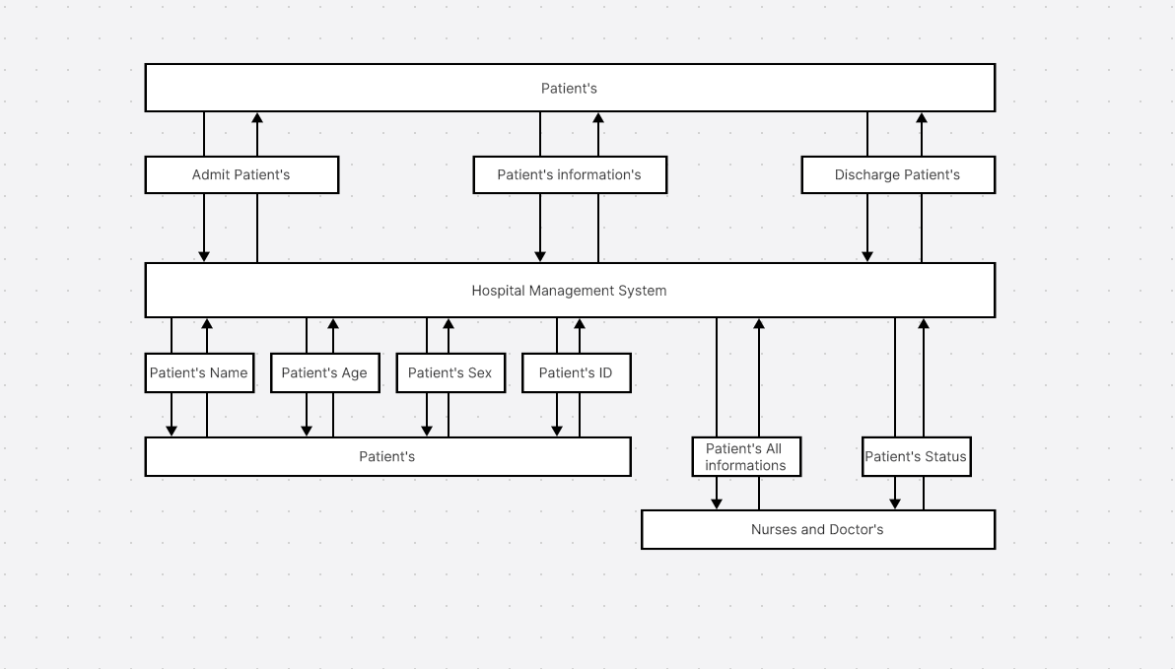
EXISTING CONTEXT DIAGRAM

Slide 7
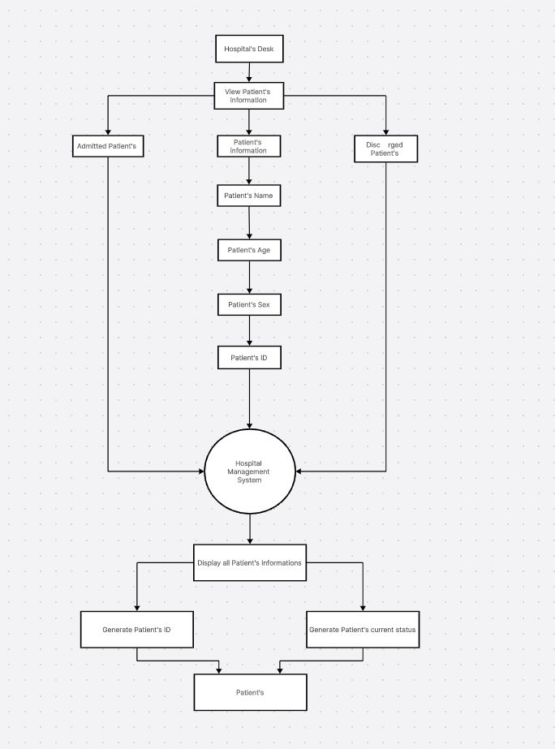
PROPOSED CONTEXT DIAGRAM

Slide 8
EXECUTIVE SUMMARY
EXECUTIVE SUMMARY

Slide 9
System
Presentation

Slide 10
Thank You!

